Slide 1
TripAdvisor Hotel Review Prediction
CMPE 255: Team 10
Nithil Sethupathi
Jinfan Zhang
Tajbir Sandhu

Slide 2
Background
Review sites are commonly used by consumers
Yelp, TripAdvisor, Google Reviews, etc.
Reviews are useful to companies
Review sites might want to make recommendations
Company might want to gage consumers sentiment on product or service
Difficult to determine sentiment by hand
Too many reviews to be reasonably done by hand
Automation needed

Slide 3
Solution
Create model to predict sentiment or review score
Should only need text input
Needs an accuracy above 60% for review
Needs an accuracy above 80% for sentiment

Slide 4
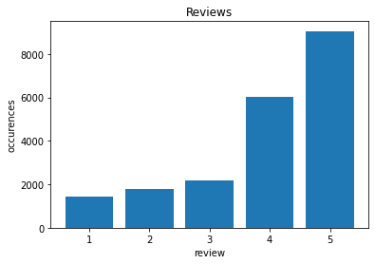
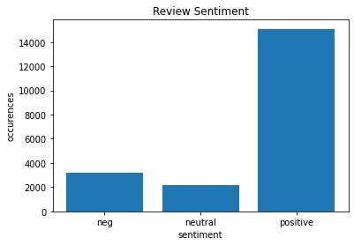
Data Set

Slide 5
Preprocessing
Remove non-alphabet characters
Remove stopwords
the, and, is, etc.
Derive sentiment
Review score of 1 or 2 is negative
Review score of 3 is neutral
Review score of 4 or 5 is positive

Slide 6
Algorithms
Gaussian Naive Bayes
AdaBoost
Multilayer Perceptron
Multinomial Logistic Regression
Convolutional Neural Network

Slide 7
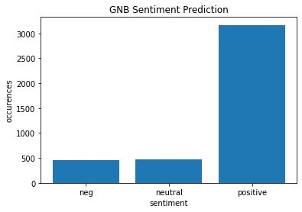
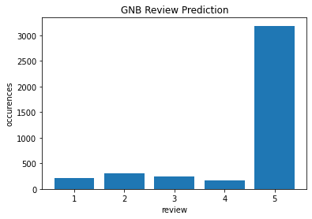
Gaussian Naive Bayes
Review Accuracy: 38%
Sentiment Accuracy: 61%

Slide 8
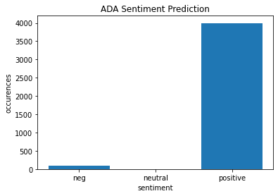
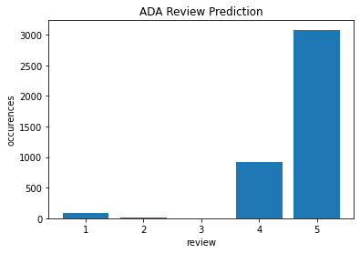
AdaBoost
Review Accuracy: 44%
Sentiment Accuracy: 72%

Slide 9
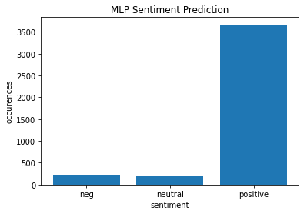
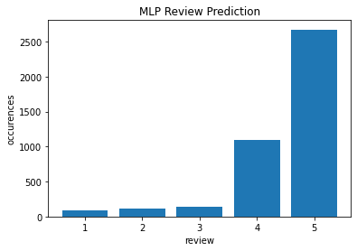
Multilayer Perceptron
Review Accuracy: 38%
Sentiment Accuracy: 66%

Slide 10
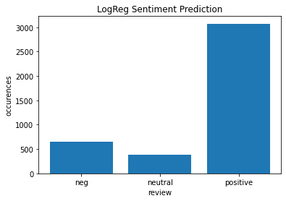
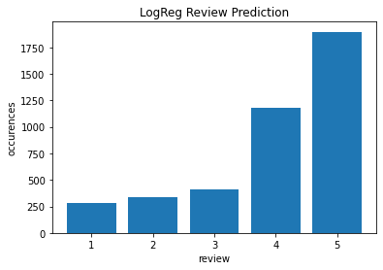
Multinomial Logistic Regression
Review Accuracy: 58%
Sentiment Accuracy: 83%

Slide 11
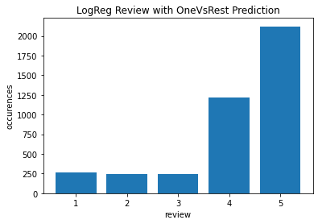
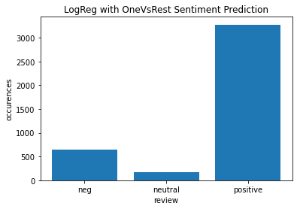
Logistic Regression with OneVsRest
Review Accuracy: 60%
Sentiment Accuracy: 84%

Slide 12
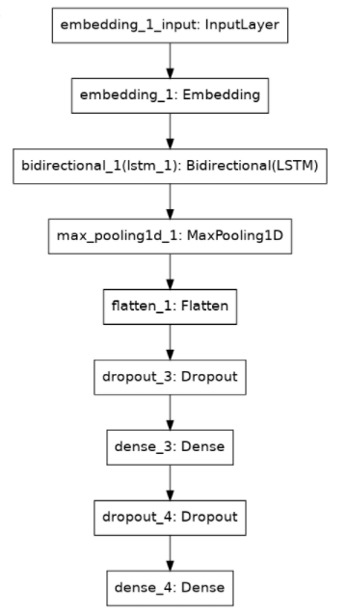
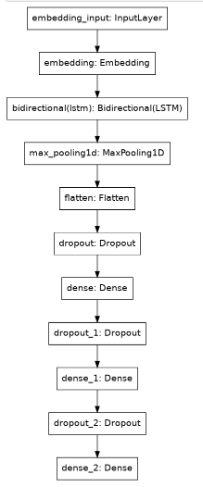
Convolutional Neural Network
Model Structure
model_rating
model_sentiment

Slide 13
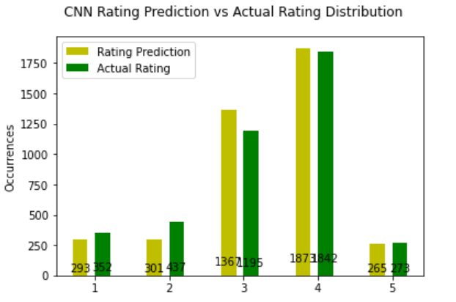
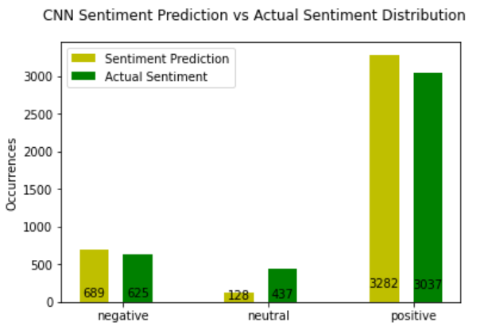
Convolutional Neural Network
Review Accuracy: 62%
Sentiment Accuracy: 85%

Slide 14
Conclusion
Imbalanced data makes learning hard
Sentiment easier to predict than user reviews
Acceptable review prediction results can be achieved with CNN
Great sentiment prediction results can be achieved with CNN

